Slide 1

SENTIMENT ANALYSIS
DWDM MINI PROJECT
GUIDED BY- AMIT SAVYANAVAR

Slide 2

Agenda
PROBLEM STATEMENT
OBJECTIVES
TOOLS USED
DATASET DESCRIPTION
DATA PREPROCESSING
SYSTEM ARCHITECTURE
DATA MINING TASKS
OUTPUT
VISUALISATION
CONCLUSION

Slide 3

PROBLEM STATEMENT
To classify the polarity of a given text at the document, sentence or feature – whether the expressed opinion in a document, a sentence or an entity is positive, negative or neutral.
To use IMDb dataset, preprocess the data, remove any noise from data and to classify if the reviews given to any movie are positive, negative or neutral by using machine learning and deep learning, monkey learn API and BIGML approaches.

Slide 4
OBJECTIVES
To use Pandas, Keras, NLTK, Numpy, Monkey Learn API to classify the sentiment of any sentence.
To try different machine learning and deep learning approaches to classify the sentiments.
To use Word Tokenization and identifying different “stopwords” from the dataset to steam the data.
To use Naïve Bayes Classifiers.
To implement neural networks for data classification

Slide 5
TOOLS USED
NLTK
RE
Keras
Pandas
NumPy
Monkey Learn API

Slide 6
DATASET DESCRIPTION
This is a movie dataset which is the collection of movie reviews from IMDB dataset having 10K movie reviews for natural language processing or Text analytics.
This is a dataset for binary sentiment classification containing substantially more data than previous benchmark datasets. We provide a set of 8,000 highly polar movie reviews for training and 2,000 for testing.
So, predict the number of positive and negative reviews using either classification or deep learning algorithms. This dataset contains two columns namely, review and sentiment.

Slide 7
DATASET PREPROCESSING
Word Tokenization
Identifying stop words
Stemming

Slide 8
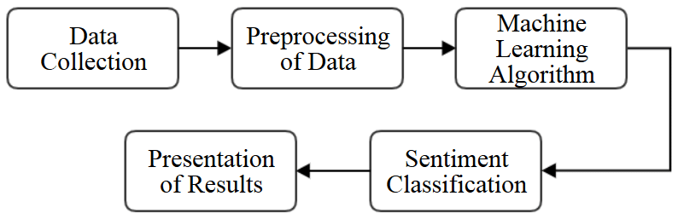
SYSTEM ARCHITECTURE

Slide 9
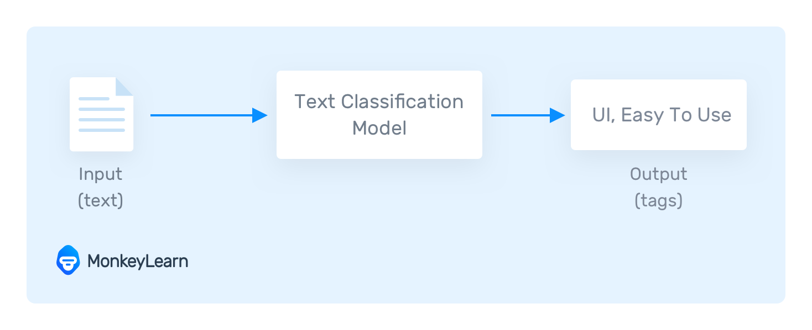
DATA MINING TASK PERFORMED
Text Classification:

Slide 10
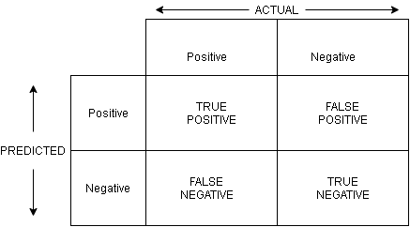


OUTPUT
Machine Learning confusion matrix
Deep Learning confusion matrix

Slide 11
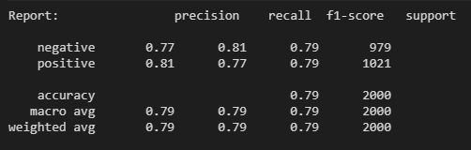
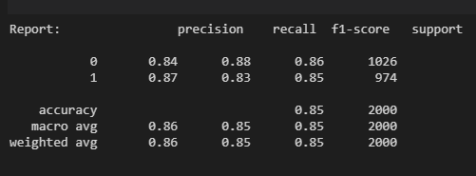
OUTPUT
Using Machine Learning approach
b. Using Deep Learning Approach

Slide 12
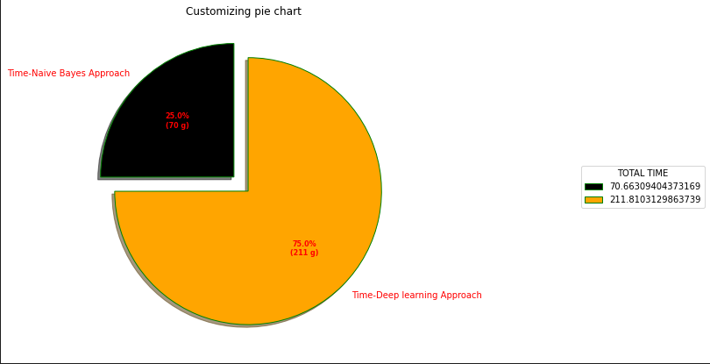
Visualization Screenshots

Slide 13
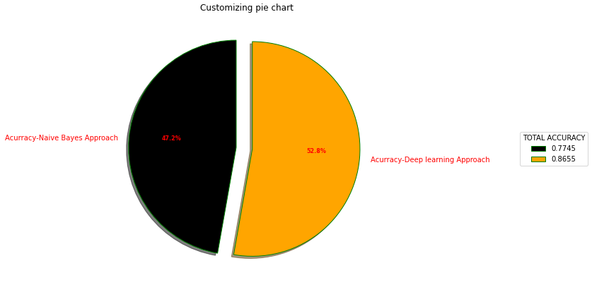
VISUALISATION SCREENSHOTS

Slide 14
CONCLUSION
The growth of sentiment analysis is one of the most active research areas of the last 10 years is due to different reasons. First, sentiment analysis has a wide array of applications, in almost every domain.
Second, it offers many challenging research problems that have never been studied before. Third, with the advent of the big data technologies, we now have a huge volume of opinionated data recorded and easily accessible in digital forms on the web.
These reasons have motivated the recent advances in the state of the art presented in this chapter. Most of the work regarding polarity classification usually considers text as unique information to infer sentiment, disregarding that social networks are actually networked environments.

Slide 15




Meet the team
BHUSHAN PANDE
PF06
Kavisha Tayal
PF13
PRATHAMESH JADHAV
PF12
ROHIT JADHAV
PF15

Slide 16
THANK YOU

